Slide 1
Examples of Sound Screening:
Neural Tube Defects and Down’s Syndrome
Jack Canick
Department of Pathology and Laboratory Medicine
Alpert Medical School of Brown University
Women & Infants Hospital
RSM & MSS Workshop:
Professional Responsibility in Medical Screening
22 May 2009
Chandos House, London

Slide 2
Prenatal screening for serious fetal disorders
The disorder is already present.
Therefore, prevention involves the offer of pregnancy termination.
The programmatic sequence is:
All pregnant women are candidates for screening
A simple, non-invasive test is applied at the right time
The test identifies a high risk group
The high risk group is offered diagnostic testing
Those confirmed to be affected are offered the option of pregnancy termination.

Slide 3
Fetal Neural Tube Defects and Down’s Syndrome:
Are the Disorders Worth Screening For?
The disorders - common and well-defined
- substantial morbidity and mortality, with life long management issues
The remedy - acceptability of pregnancy termination
The screening test - simple, safe
- performance well understood
- test is inexpensive
Current issues - accessibility of the test?
- equity in offering the test?

Slide 4
How good is prenatal screening and has it been effective?
Test Quality as Shown by ROC Curves
100
perfect
test
invasive test offered to all women (e.g., amnio, CVS)
Detection Rate (%)
50
worthless screening test
0 50 100
False Positive Rate (%)

Slide 5
How good is prenatal screening for neural tube defects and has it been effective?
Screening for Open Spina Bifida using Maternal Serum AFP
Screening cut-off | DR | FPR
AFP ≥2.0 MoM | 92% | 2%
AFP ≥2.5 MoM | 85% | 0.3%

Slide 6
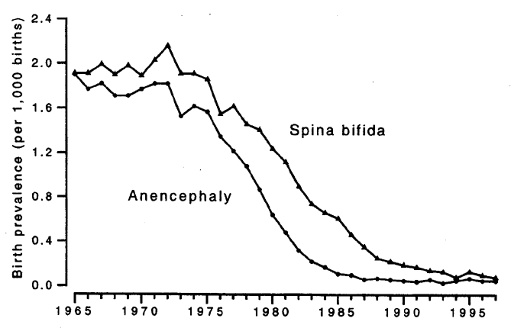
How good is prenatal screening for neural tube defects and has it been effective?
Prevalence of NTDs at Birth in England and Wales 1965-1997
Adapted from: Wald NJ, Leck I. Antenatal and Neonatal Screening, Oxford, 2000

Slide 7
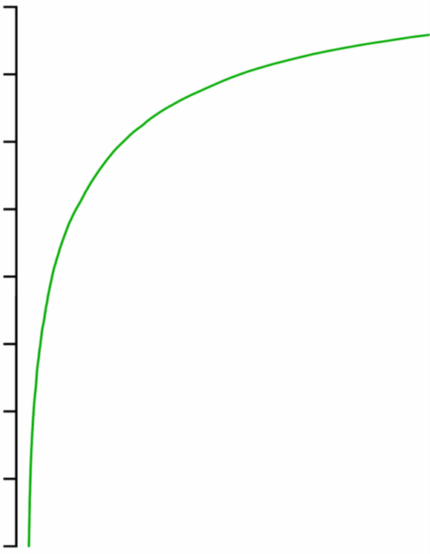
Screening Performance:
2nd Trimester Triple Test
2nd trim.
AFP
uE3
β-hCG
100
90
80
70
60
50
40
30
20
Triple
70% DR
5% FPR
Detection Rate (%)
0 5 10 15 20 25 100
False Positive Rate (%)

Slide 8
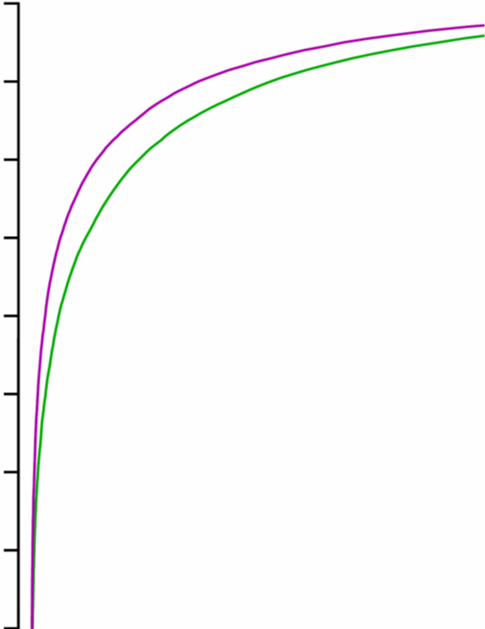
Screening Performance:
2nd Trimester Quad Test
2nd trim.
AFP
uE3
β-hCG
inhibin A
100
90
80
70
60
50
40
30
20
Quad
Triple
80% DR
5% FPR
Detection Rate (%)
0 5 10 15 20 25 100
False Positive Rate (%)

Slide 9
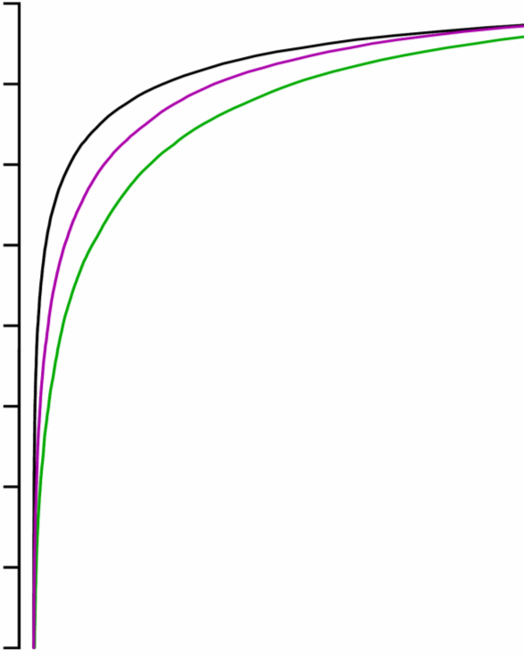
Screening Performance:
1st Trimester Combined Test
1st trim.
NT
PAPP-A
β-hCG
100
90
80
70
60
50
40
30
20
Combined
Quad
Triple
85% DR
5% FPR
Detection Rate (%)
0 5 10 15 20 25 100
False Positive Rate (%)

Slide 10
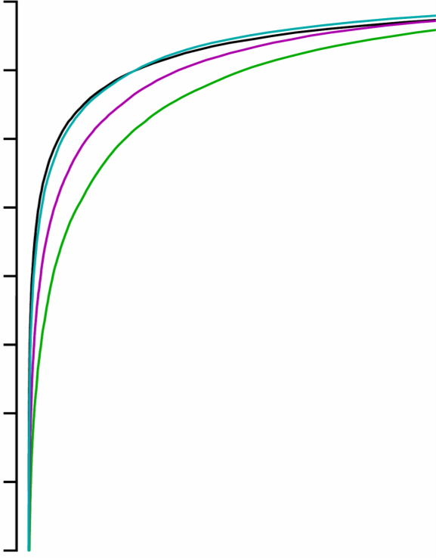
Screening Performance:
Serum Integrated Test
1st trim.
PAPP-A
2nd trim.
AFP
uE3
β-hCG
inhibin A
100
90
80
70
60
50
40
30
20
Serum Integrated
Quad
Triple
Combined
85% DR
5% FPR
Detection Rate (%)
0 5 10 15 20 25 100
False Positive Rate (%)

Slide 11
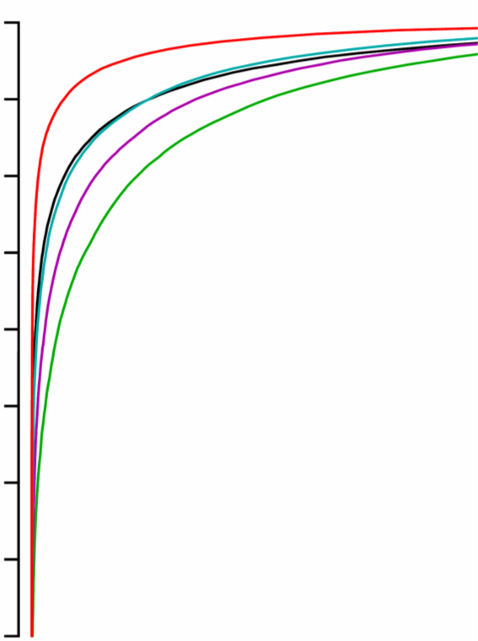
Screening Performance:
Full Integrated Test
1st trim.
NT
PAPP-A
2nd trim.
AFP
uE3
β-hCG
inhibin A
100
90
80
70
60
50
40
30
20
Full Integrated
Quad
Triple
Combined
Serum Integrated
95% DR @ 5% FPR
Detection Rate (%)
or
90% DR @ 2% FPR
0 5 10 15 20 25 100
False Positive Rate (%)

Slide 12
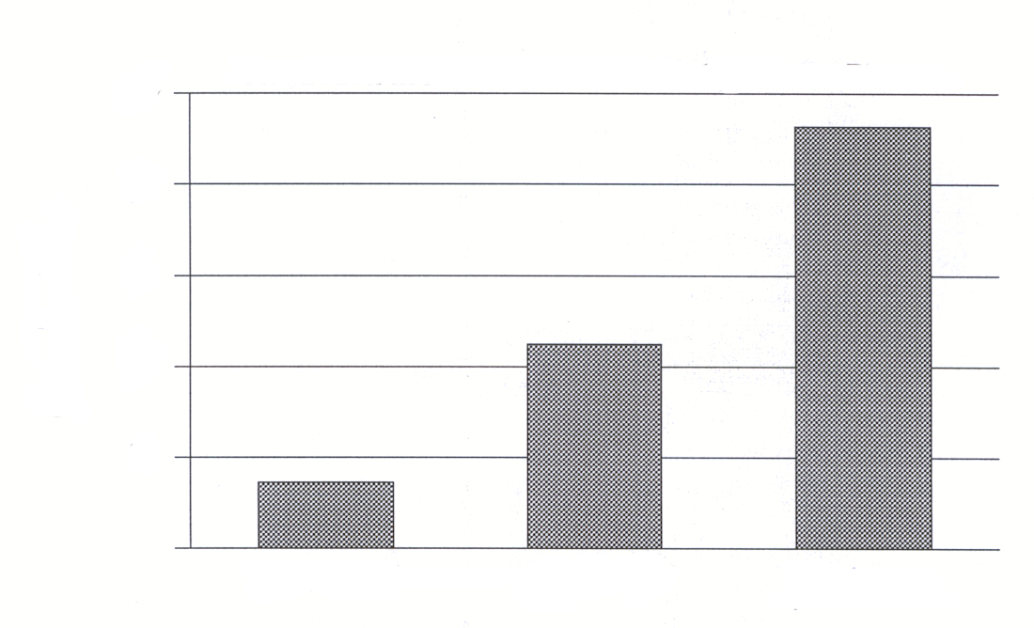
How good is prenatal screening for Down’s syndrome and has it been effective?
Triple test
(AFP, uE3, hCG)
50
40
30
AFP and age
Percent Reduction
20
maternal age alone
10
1980-85
1986-90
1991-93
GE Palomaki, JE Haddow, LJ Beauregard, New Engl J Med, May 23,1996.

Slide 13
Current Issues in Prenatal Screening for NTDs and Down’s Syndrome: Equity, safety, and accessibility
NTD screening:
shift from maternal serum AFP at 15-18 weeks to the fetal anomaly U/S scan at 18-22 weeks
MSAFP test performance is well characterized
anomaly scan test performance is believed to be very good, but is not well characterized
later decision making and termination of pregnancy
availability of an U/S scan vs availability of a lab test
Cost of an U/S scan vs cost of a lab test for AFP

Slide 14
Current Issues in Prenatal Screening for NTDs and Down’s Syndrome: Equity, safety, and accessibility
Down syndrome screening:
Is the best (i.e., the safest) test being utilized?
  Overall: the full Integrated Test
  For those seeking early diagnosis: the first trimester Combined Test.
The best tests require nuchal translucency (NT) scan.
  Is there equity in the availability of NT scan?
  Does the cost of adding NT scan make screening too expensive?
  availability of scan vs availability of a lab test
  cost of scan vs cost of a lab test for AFP

Slide 15
Examples of Sound Screening:
Neural Tube Defects and Down’s Syndrome
Conclusions:
Prenatal screening for open neural tube defects and Down syndrome is, by now, a stable, well characterized program, with clear performance expectations.
Judgments regarding changes in method, intended to improve such screening, must be carefully evaluated by professionals using all of the evidence at hand.
While there are always improvements to evaluate, the basic methods in antenatal screening are sound.

